Slide 1
Deep Learning: Issues and Solutions (aka Engineering or “Trial and Error”)
Balaji Padmanabhan
Professor, Information Systems & Decision Sciences
Director, Center for Analytics & Creativity
Muma College of Business, USF
bp@usf.edu

Slide 2
Main Issues in Training DL Models
Vanishing Gradients (or exploding gradients) problem
Backpropagation does not have any updates to lower layers as training continues because gradients are very low
Solutions:
careful initialization of weights
activation functions
Reusing DL layers from pre-trained networks
Freezing lower layers for some part
Making algorithmic tweaks to gradient descent

Slide 3
Main Issues in Training DL Models
Improving training time
Trying different optimizers other than the default gradient descent
Tweaking learning rates in gradient descent models
Momentum optimization or Nesterov accelerated gradient methods are some options
But this is still being explored in research
Use parts of other DL networks

Slide 4
Main Issues in Training DL Models
Generalization
Early stopping by monitoring training
l₁ and l₂ regularization, but making changes to the cost function to constrain the weights
Dropout
At every training step, each neural has a probability p of being completely ignored in the forward propagation
Max-norm regularization to constrain the weights of each neuron
Data augmentation, artificially increasing your training data set with clever tricks to add more points for learning

Slide 5
ACTIVATION FUNCTIONS

Slide 6
Activation Functions & Derivatives

Slide 7
ReLU vs Sigmoid Activation Functions
Sigmoid transfer functions level out at 1, so for higher values of the input there is no gradient
For deep learning networks, the math multiplies gradients, which can very quickly go to zero if sigmoid is used, unlike the ReLU case.
Rectified Linear Unit (ReLU) activation function in a neural network node is h=max(0,a) where a=wx+b
So output is not bounded to 1, derivative is constant for high values of a

Slide 8
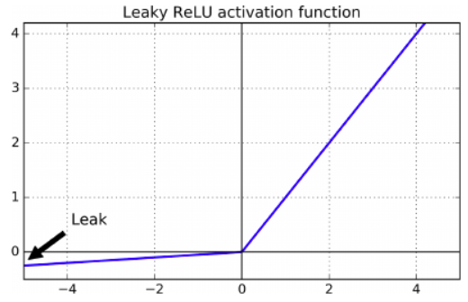
Leaky ReLU (on the negative side)
Solution: Leaky ReLU
Small slope for <0 makes sure a neuron doesn't "die"
It produces a value close to 0, but may eventually "wake up"
In tests, leaky ReLU performs better than ReLU

Slide 9
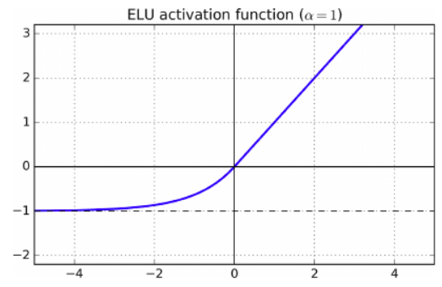
Exponential Linear Units (ELU)
Another solution: ELU (exponential linear unit)
Negative values when <0 help with vanishing gradient
None-zero gradient avoids dying neurons
Slope is 1 when >0, which speeds up gradient descent
Drawback: slower than ReLU and its variants!
Advantage: faster convergence rate

Slide 10
INITIALIZATION

Slide 11
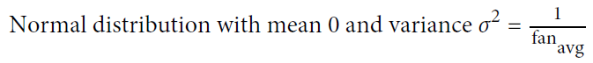
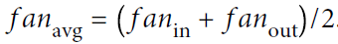
Xavier (Glorot) Initialization
Initialize the connection weights using:
This is the default setting in Tensorflow:
tf.keras.layers.dense()

Slide 12
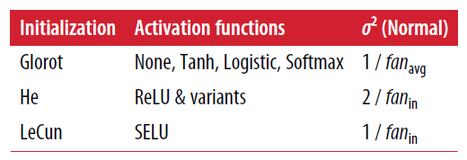
Other Initializations

Slide 13
Batch Normalization
Generate the “optimal scale” and “mean” of inputs for each layer:
Right before activation, zero-center and normalize the inputs
Then, scale and shift the results

Slide 14
Batch Normalization
If batch normalization is used, experiments show:
You can use logistic (sigmoid) activation function
You can use tanh activation function
Networks are not sensitive to weight initialization
Can use much larger learning rates
Slower training (due to new computations in each layer)
Performed as follows:
tf.keras.backend.normalize_batch_in_training()

Slide 15
Architecture
Choosing the “right” architecture in terms of designing and combining layers
CNN and RNN are two canonical forms. Many other variations and combinations exist and this is an active area of research.

Slide 16
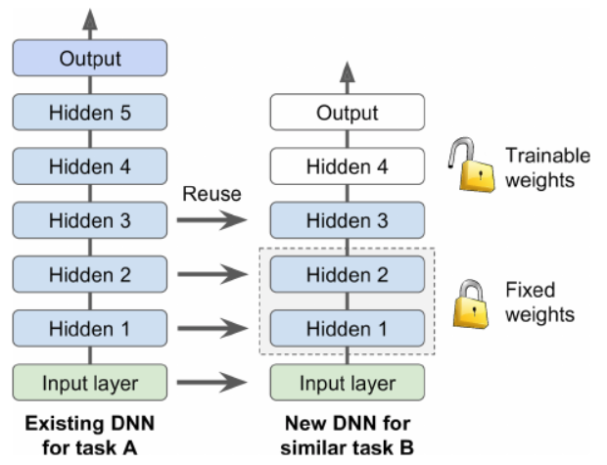
Reusing Pretrained Layers
Can't train large DNNs always from scratch
Find an existing DNN, reuse lower layers
Called transfer learning
Example: a DNN that classified 100 different categories
Reuse lower layers to build a DNN for specific vehicle types

Slide 17
Where to Find Existing DNNs?
TensorFlow's model zoo (https://github.com/tensorflow/models)
Caffe's model zoo (https://github.com/ethereon/caffe-tensorflow)
You can:
Use Transfer Learning Ideas
Import the entire graph (import_meta_graph())
Restore model state using checkpoints
Specify the layers you want to use
Train upper layers

Slide 18
OPTIMIZER

Slide 19
Optimizers
So far, we have seen Gradient Descent
Are there other faster/better optimizers?
Momentum
Nesterov Accelerated Gradient
AdaGrad
RMSProp
Adam

Slide 20
Momentum Optimization
A value between 0 (high friction) and 1 (no friction)
Typical value is 0.9 (this makes it 10 times faster than Gradient Descent)
Can escape plateaus much faster
Can get past local optima

Slide 21
Nesterov Accelerated Gradient
A faster variant of momentum optimizer
Measures the gradient a little farther than plain momentum
Reaches optimum faster

Slide 22
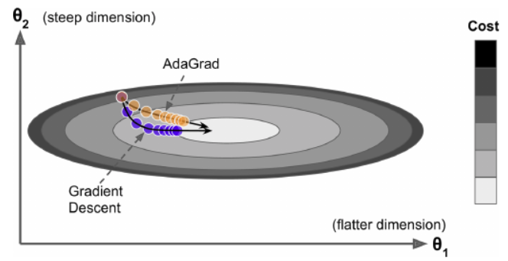
AdaGrad
Adaptive Gradient
Instead of rolling down the hill, detect steepest slope, then point straight at the global optimum

Slide 23
RMSProp
Uses exponential decay (gradients only from the last iteration are used)
This prevents slowing down (like AdaGrad)
The decay value is usually set to 0.9

Slide 24
Adam
Adaptive Moment Estimation
Combines Momentum and RMSProp
Hyperparameters:
Momentum decay: 0.9 (typical value)
Scaling decay: 0.999 (typical value)
Smoothing term: a very small number (10⁻⁸)
Can use a small learning rate (0.001)

Slide 25
LEARNING RATE SCHEDULING

Slide 26
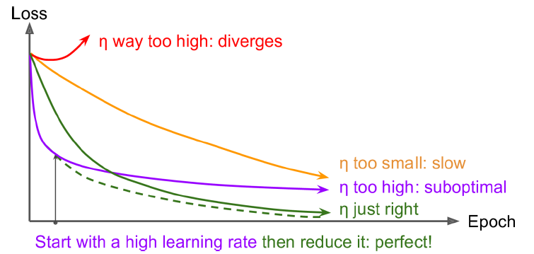
Learning Rate Scheduling
High learning rate can cause diverging solution
Low learning rate can take too long

Slide 27
Learning Rate Scheduling
What about changing the learning rate during training!
0.1 for 50 epochs, then 0.001 afterwards
OR: measure error every N steps, reduce learning rate by a factor
OR: set the learning rate to a function of the iteration number
OR: power scheduling to reduce the learning rate slowly
AdaGrad, RMSProp, and Adam change learning rate automatically
No need to create learning schedules for these

Slide 28
AVOIDING OVERFITTING

Slide 29
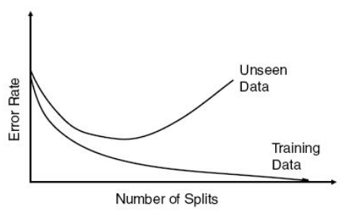
Early Stopping
Measure both train and validation error
Stop when validation error increases
Validation
Data
Number of iterations

Slide 30
L1 and L2 Reg.
Use L1 and L2 regularization to constrain the weights of neurons
l1_regularizer(),
l2_regularizer(),
l1_l2_regularizer()

Slide 31
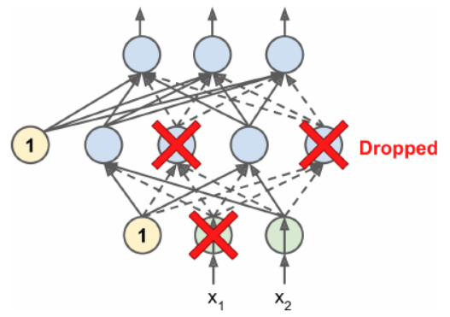
Dropout
Can increase accuracy by 1-2%
At every training step, each neuron has a probability of p of being ignored during training
A dropped neuron in the current step can be active in the next step
Set to 50%
Increase if overfitting
Decrease if underfitting

Slide 32
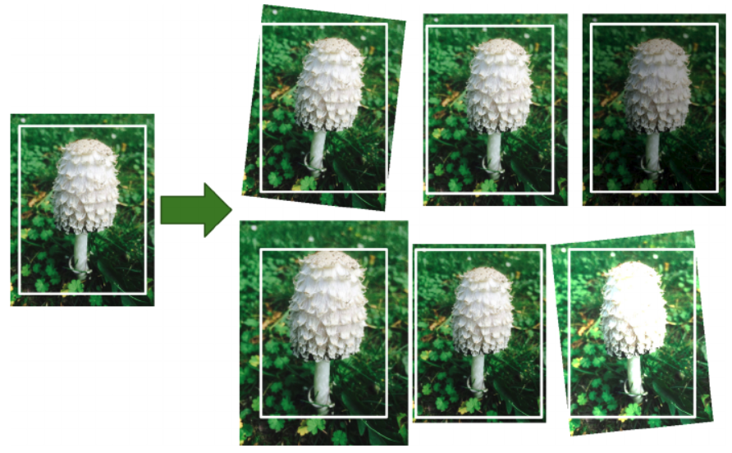
Data Augmentation
Generate new data instances from existing ones

Slide 33
Avoid Overfitting
Will we use overfitting prevention to train DNNs?
Absolutely!!!
All (except max-norm regularization)

Slide 34
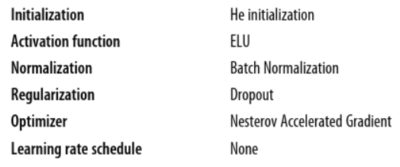
Practical Guidelines
Book recommendations:
Further tweaks:
Use data augmentation if not enough training data
Use a learning schedule
Use L1 regularization if need a sparse model
Drop batch normalization, and replace ELU with leaky ReLU for faster training

